Slide 1
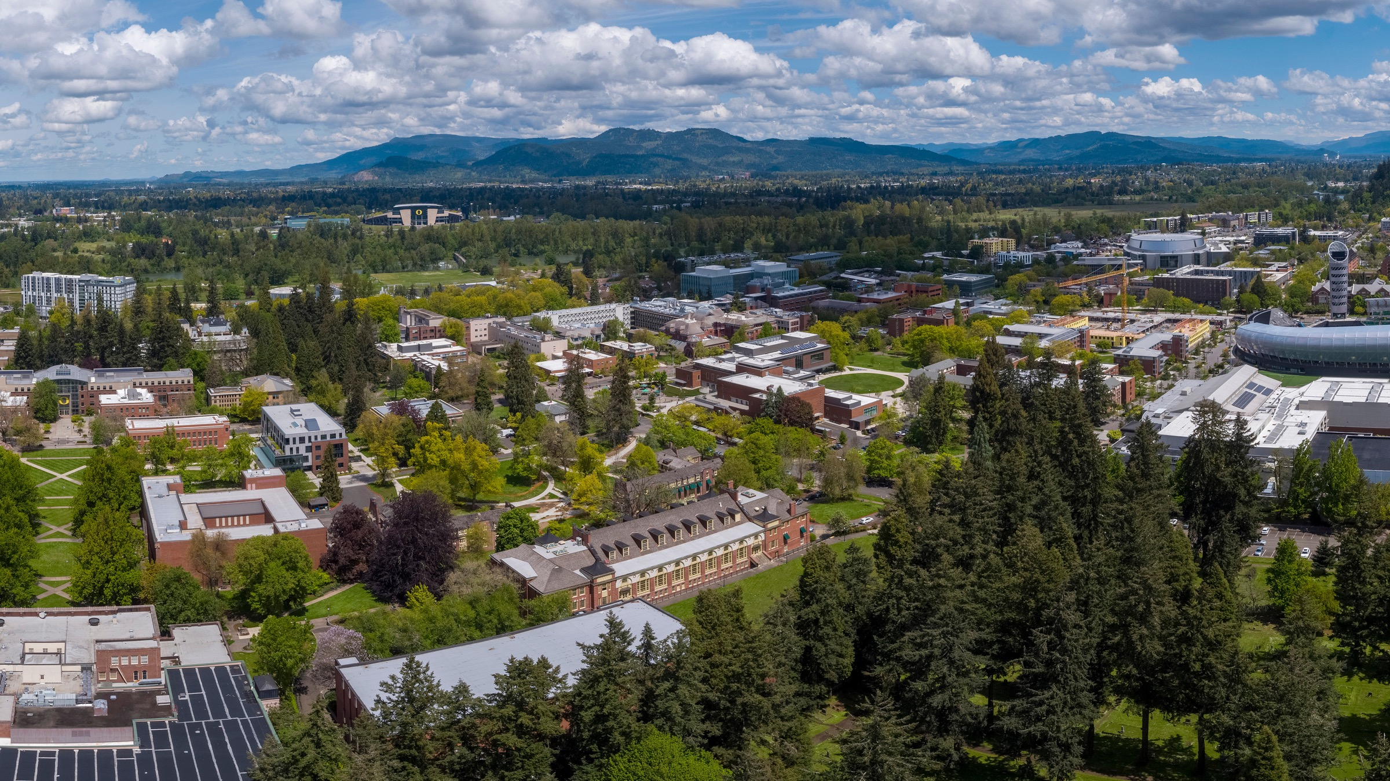

Planning for Summer Travel
International Student & Scholar Services

Slide 2
Agenda
  International travel
  Domestic travel
  OPT travel
  Travel for pending ‘green card’
  Visa revocations + renewals
  Loaner laptops & export controls
  Graduate research outside the US
  Study Abroad students
  Re-entry to the US
  Engaging with CBP at border
  USCIS registration requirement
  Real ID
  Interactions with law enforcement
  Scams
  Maintaining legal status
  Address requirement
  Supplemental summer funding
  Summer CPT
  I-20 extensions
  Transferring to another institution
  Graduate Students Defending Summer
  Legal resources

Slide 3

What you need to know to travel safely and with confidence
In general, you should feel confident to travel. Most of what you hear and read will not impact you. Be prepared and confident, but exercise caution.
How to Prepare:
Refer regularly to ISSS Immigration Resources website for updates on immigration policy changes
Ask yourself a few simple questions:
  Is your visa still valid?
  Is your SEVIS record active? (ISSS will contact you if your SEVIS is terminated)
  Is your I-20 or DS-2019 still valid and signed for international travel?
  Have you screened your social media accounts for any concerns?
If you answered ‘Yes’ to these questions, you are ready to travel!
6

Slide 4
What you need to know to travel safely and with confidence
Are you prepared for increased screening and searches upon re-entry?
  Have your documents on you and not packed in your luggage
  Be prepared to answers questions about your purpose for being in the US
  Secure your electronic devices
Has your visa been revoked?
  Dept of State will notify you using the email address from your visa application
  If your answer is ‘Yes’, do not travel and consult an immigration attorney
  A revoked visa could result in removal proceedings
  If you do leave the US, you must apply for a new visa before re-entering the US
6

Slide 5
Visa Revocations
  The Department of State has the authority to revoke visas for arrests, criminal charges, or convictions, as well as any behavior that's deemed to be of concern to the current administration.
  Check if your visa has been revoked on the US Department of State website.
    You will need your visa application ID number or case number from the visa application submission confirmation.
  If your visa has been revoked, consult with a lawyer before traveling.
6

Slide 6
SEVIS Terminations
SEVIS is the gov’t system under Dept of Homeland Security/ICE/SEVP that allows us to sponsor F-1 and J-1 students and their dependents.
ISSS manages your SEVIS record to ensure you are remaining in legal status
There have been no new terminations since April
Federal government reversed all terminations from March/April
There are indications they may start terminating records again but with more scrutiny
ISSS checks daily and will notify you if your SEVIS has been terminated
6

Slide 7
Travel ban
A travel ban has not yet been announced by Dept of State
If there is a travel ban, some international students may be impacted depending on the details of the travel ban – most likely to impact new students applying for visas
A travel ban does not mean you will lose your legal status in the U.S.
ISSS will notify impacted students as soon as we know and will provide support
6

Slide 8
Prepare for International Travel
  Carry emergency contacts
    ISSS: 541-346-3206
    UOPD Dispatch: 541-346-2919 (UOPD dispatch will connect you with ISSS after hours)
    UO General Counsel: 541-346-3082 (if detained by US immigration or law enforcement)
    Legal Resources (print slide at end of presentation)
  Request an Enrollment & Visa Status Verification Letter
    Log into iconnect.uoregon.edu
    Click on F-1 Student Services
    Submit the Enrollment & Visa Status Verification Letter e-form
6

Slide 9
Prepare for International Travel
  Request a travel signature on your I-20 or DS-2019
    Request online at iConnect
    Bring your documents to ISSS (Oregon Hall, 3rd floor)
      M, T, W, F 1:30 pm – 3:30 pm
    Come to an all-day travel signature clinic in ISSS (Oregon Hall, 3rd floor)
      June 4, 10 am - 3:30 pm
      June 12, 10 am – 3:30 pm
    Travel signatures are valid for one year (6 months for students on OPT)
  Review FAQs for International Travel: Immigration Resources
6

Slide 10
Prepare for International Travel
  Carry required documents:
    Unexpired Passport: ensure that your passport is always valid beyond six months
    Unexpired Visa: confirm your visa is still valid for re-entry
    Student Status:
      I-20 or DS-2019
      SEVIS fee payment receipt (download at FMJfee.com)
      proof of financial support
      transcript
      class schedule for current or upcoming term
6

Slide 11
For OPT Students
If traveling during your OPT period, carry
  all required documents for international travel PLUS
  Employment authorization document (EAD or OPT card)
  Proof of employment
If re-entering the US before your OPT start date and your OPT is still pending, carry
  all required documents for international travel PLUS
  I-765 receipt notice
  Job offer or evidence of job search (resume, cover letters, emails to employers)
When you are on OPT, you are still in F-1 status sponsored by ISSS/UO.
Your purpose for being in the US is for work/practical training related to your major
6

Slide 12
For Students Applying for a ‘Green Card’
Make sure you consult with your immigration attorney before leaving the US
If you travel while your permanent residence application is pending, you must obtain an ‘Advance’ Parole travel permit for re-entry to the US
  If you re-enter with Advance Parole, you will no longer be in F-1 status and must notify ISSS so we can terminate your SEVIS record for change of status
6

Slide 13
Expired Visa
  A US visa can expire while you are in the US in legal status
    You can legally stay in the US - a valid visa is not a condition of legal status
    You don’t have to leave the US just to renew your visa
  Renewing a visa
    You can only renew a visa at a US embassy or consulate outside the US.
    Contact list for US embassy or consulate in your home country
    Review Dept of State policy change on visa interview waivers
  If your visa is denied, email ISSS at intl@uoregon.edu so we can advise and support
6

Slide 14
Immigration Visa Support Pop-Up Event
The University of Oregon is partnering with Equity Corps of Oregon (ECO) to facilitate a pop-up event for students affected by or concerned about the recent events.
Wednesday, May 28
9:00 - 10:00 a.m. information session (virtual)
11:00 a.m. - 4:00 p.m. immigration consultations for registrants
If you are interested in speaking with an immigration attorney about your specific immigration case on the day of the event, please complete the registration form. Consultations are on an as-needed basis and pending ECO enrollment and eligibility. Sign up for a FREE consultation and the virtual information session.
6

Slide 15
Loaner Laptops
  Loaner laptops are available for official UO travel (not available for personal travel) depending on availability
  Loaner laptops may be required for official UO travel to certain countries (incl. China, Hong Kong, and Iran)
  Export Control Officer must take steps for any UO laptop which is carried to China, Hong Kong, Russia, and Venezuela (not personal laptops)
  Contact exportcontrols@uoregon.edu to inquire
6

Slide 16
Export Controls - Only for official UO travel
  Most student activity is exempt from export controls
  Personal travel is not under UO Export Control jurisdiction
  Official UO travel must be logged in Concur
    Export Control Officer completes required reviews
    Compliance support is crucial for certain destinations; log travel in Concur and process is automatic
  Travelers to Iran, Syria, or Cuba should contact exportcontrols@uoregon.edu when they begin making travel plans
6

Slide 17
Graduate Summer Research Outside the US
  Questions to ask and discuss with your graduate program:
    Will you be working as a GE while outside the US?
    Will you be required to register?
    Will you continue to remain outside the US for longer than summer term?
  If you will work as a GE while outside the US:
    You cannot work for more than 90 days without prior approval.
    Prior approval must come from your graduate department -
      Employee Working Outside Oregon
6

Slide 18
Graduate Students Defending Summer Term
Your F-1 or J-1 visa status is tied to your final term of enrollment, not a summer thesis or dissertation defense date.
If you are defending summer term but will not be enrolled in summer credits, your F-1 or J-1 visa status will end spring term.
On-campus employment authorization ends with your final term of enrollment
You can still defend in the summer, but you must meet with an ISSS advisor to plan out your options including:
  When to apply for OPT (F-1) or Academic Training (J-1)
  Whether spring or summer term is considered your ‘final term’
6

Slide 19
Study Abroad Outside the US
  If you are going on a GEO study abroad program:
    Submit a Temporary Leave from U.S. e-form at iconnect.uoregon.edu (under F-1 Student Services) for the term/s you will be outside the U.S.
    Meet with an ISSS advisor to make sure you have the required documents for re-entry to the US after your study abroad program
6

Slide 20
Re-Entry to US
Engaging with Customs & Border Protection (CBP)
Be prepared to show your passport, visa and I-20 or DS-2019 and expect delays in increased security.
You may be asked about your purpose, itinerary, destination, and duration. You should answer all questions accurately and honestly. Any misstatements may be construed as fraud or misrepresentation. If you do not understand a question, ask the officer to repeat it or rephrase it for you.
You should only answer the questions you are asked. Be concise and direct. A simple “yes” or “no” is sufficient. Do not volunteer information or provide unnecessary information.
6

Slide 21
Re-Entry to US
If you are asked questions related to who you know or national security concerns, you can answer and say, “I’m not comfortable answering these questions.” If they insist, call Office of General Counsel at (541) 346-3082 or an immigration attorney.
Customs & Border Protection (CBP) claims the authority to search, copy, or even seize electronic devices, including smartphones, laptops, and tablets, without a warrant.
Prepare for electronic device searches at US ports of entry. Review What You Need to Know.
Review Know your Rights: Enforcement at Airports
6

Slide 22
USCIS Registration Requirement for Non Citizens
  All non-citizens are required to carry evidence of registration with the US government
  I-94 admission record is evidence of registration
    Download and print your most recent I-94 at CBP I-94 Website, click on ‘Get Most Recent I-94’). You must carry this with you at all times.
  Currently in Effect: The registration requirement took effect on April 11, 2025. There are penalties for failing to carry proof of registration
  For more information: refer to ISSS’ Immigration Resources
6

Slide 23
Prepare for Domestic Travel
  Carry emergency contacts
    ISSS: 541-346-3206
    UOPD Dispatch: 541-346-2919 (UOPD dispatch will connect you with ISSS after hours)
    UO General Counsel: 541-346-3082 (if detained by US immigration or law enforcement)
    Legal Resources (print slide and keep with your documents)
  Request an Enrollment & Visa Status Verification Letter
    Log into iconnect.uoregon.edu
    Click on F-1 Student Services
    Submit the Enrollment & Visa Status Verification Letter e-form
6

Slide 24
Prepare for Domestic Travel
  Carry required documents:
    Unexpired Passport or Real ID
    Student Status: I-20 or DS-2019, SEVIS fee payment receipt, proof of financial support, transcript and class schedule for current or upcoming term
    Evidence of Registration: I-94 admission record (download at https://i94.cbp.dhs.gov/home and click on ’Get Most Recent I-94’
    Employment Authorization: CPT I-20, OPT I-20, OPT EAD Card, I-765 receipt notice and proof of employment
6

Slide 25
Real ID vs Foreign Passport
  Effective now, all domestic travel in the US requires one of the following accepted forms of identification:
    Foreign passport, or
    Real ID (apply at a DMV office)
  If your visa has expired, you are not eligible for Real ID
  Airport security will not accept regular driver’s licenses or state IDs that are not Real ID credentials
  Full list of acceptable Real ID: tsa.gov/travel/security-screening/identification
6

Slide 26
Traveling to Alaska, Hawaii and Nearby US Territories
  Travel to Hawaii or Alaska is considered a domestic flight.
  Travel to Puerto Rico, the U.S. Virgin Islands, and certain other U.S. territories are part of the United States and considered a domestic flight.
  Intl students do not need a visa to travel to these locations if departing from within the U.S. However, you must carry required documents for international travel.
  Make sure your travel does not involve transit through or short stays in other countries, since full documentation (including a valid visa) for return to the U.S. may be necessary.
6

Slide 27
Traveling to Mexico, Canada & Adjacent Islands
  You may travel to Canada, Mexico, and Adjacent Islands and re-enter the US on an expired F-1 or J-1 visa if:
    the trip does not exceed 30 days; and
    the purpose of the trip is not to apply for a new F-1 or J-1 visa
  This legality to travel on an expired visa is referred to as automatic revalidation.
    You must carry required documents for international travel.
  A visitor's visa may be required to enter Mexico, Canada & Adjacent Islands, depending on your country of citizenship.
    Contact that country's foreign consulate to determine whether a visa is required.
6

Slide 28
Additional Considerations for All Travel
  When you book your flight, make sure the name on your ticket exactly matches the identification (foreign passport) you will be presenting.
  Secure your devices (turn off face identification and turn on numerical password)
  Review your online social media to ensure it does not bring undue scrutiny on your primary purpose for being in the U.S.
  Carry your emergency contact list
  Bring a good book to read or music to listen to!
6

Slide 29
Interactions with Immigration Enforcement
The US government agency you are mostly likely to encounter in the U.S. is ICE. While ICE has broad authority to conduct investigations, you have certain rights under the Constitution regardless of your immigration status.
Your rights include:
The right to remain silent. You are not required to discuss your immigration or citizenship status with police, immigration agents, or other officials. Keep in mind that anything you tell an officer can later be used against you in immigration court.
If you are not a U.S. citizen, you must show an officer your most recent I-94 admission record, I-20 or DS-2019 and foreign passport.
6

Slide 30
Interactions with Immigration Enforcement
If an ICE officer asks to enter your home, you have the right to say no.
  ICE can only enter your home by force if they have a judicial warrant from a judge.
  A “warrant” issued by the Department of Homeland Security (DHS) is not a valid warrant to enter your home under the Constitution.
  If an ICE officer says they have a warrant to enter the home, you should ask them to show you.
Carry I-94 evidence of registration and lawful status. This is especially critical if you travel near the U.S. border where ICE has increased authority to conduct searches.
  If you don’t have your documents with you, tell the officer that you want to remain silent, or that you want to consult a lawyer or UO Office of General Counsel before answering any questions.
6

Slide 31
Interactions with Immigration Enforcement
If an ICE agent asks to search you, you have the right to say no.
  Agents need your consent or probable cause to search you and your belongings.
If you are pressured into signing a statement or waiving your rights, do not sign anything without first consulting with an attorney or UO General Counsel.
You have the right to ask if you are free to leave. If the agent says yes, leave calmly.
6

Slide 32
Interactions with Immigration Enforcement
Be polite and respectful.
If the officer requests information or presents you with a warrant, subpoena, or order, tell the officer: “I understand that you're here in an official capacity, but I’m obligated to call the UO’s General Counsel office first.”
  Get the officer’s name, ID number, agency affiliation
Contact UO General Counsel’s Office at (541) 346-3082 and provide the officer’s identification information. Email any document provided by the officer to gcounsel@uoregon.edu.
For more information, review the ISSS Immigration Resources website
6

Slide 33
Scams targeting international students- Don't fall for it!
What Scammers Do:
Call from numbers that look official and may even display “USCIS” or “IRS” on caller ID.
Demand urgent payment for a “visa violation,” “unpaid taxes,” or an issue with your Social Security number.
Pretend to be police or federal officers, sometimes using fake badge numbers.
Ask you to confirm personal details or login credentials by clicking on links in an email or text message.
Threaten severe consequences like freezing your bank accounts, arrest, or deportation if you do not comply.
6

Slide 34
Scams targeting international students- Don't fall for it!
What US Agencies & Law Enforcement Will NEVER Do:
Call, email, or text you demanding immediate payment or threatening visa cancellation, deportation, or arrest.
Ask for personal details like your Social Security number, bank information, or passwords over the phone.
Require payment through unconventional methods like gift cards, cryptocurrency, wire transfers, or prepaid debit cards.
Pressure you to act immediately with threats or scare tactics.
6

Slide 35
Scams targeting international students- Don't fall for it!
If You Receive a Suspicious Call or Email:
Do not engage. Hang up, ignore the email, and do not click on any links.
Do not provide any personal or financial information. Government agencies already have your details on file.
If you are unsure whether a message is real, contact ISSS (541-346-3206) or UOPD (541-346-2919) before taking any action.
Report the scam to the Federal Trade Commission (FTC) and to ISSS so we can warn other students.
Scammers are very convincing, but don’t let them scare you into making a mistake.
6

Slide 36
  Summer Supplemental Funding
International Student & Scholar Services: Emergency Financial Aid
Division of Graduate Studies: Graduate Assistance Fund International Summer Supplement Award (GEs only; applications open July 15)
Dean of Students: Student in Crisis Fund
Basic Needs Program: Rent & Utility Assistance
Basic Needs Program: Childcare Subsidy

Slide 37
Maintain Legal Status in the US
What documents you need to be in legal status
    Unexpired I-20 or DS-2019
    Unexpired foreign passport
    I-94 showing admission in F-1 or J-1 status
Enroll full-time, unless approved for a reduced course load by ISSS
  Minimum 12 credits for undergraduates or 9 credits for graduate students
  Only one online course allowed if enrolled in minimum required credits
Work no more than 20-hours per week on-campus when classes are in session (except during summer vacation term)
6

Slide 38
Maintain Legal Status in the US
You can work full-time on-campus (up to 40 hours per week) during summer term (unless ISSS has notified you that you are required to be full-time summer term)
Do not work off-campus without first consulting with an ISSS advisor
  Unauthorized employment off campus is grounds for SEVIS termination
  You may be eligible for Curricular Practical Training (CPT) if you have a job or internship related to your major.
Update US address within 10 days of a change of address
Report OPT employment and don’t exceed the 90-day unemployment allowance
6

Slide 39
Summer CPT Work Authorization
ISSS grants CPT work authorization for off-campus internships and employment related to your major for all international students.
Visit ISSS website to learn more about CPT eligibility, required paperwork, and approval deadlines.
Visit Career Center for help with resumes and cover letters
The Division of Graduate Studies supports grad international students with preparing to compete for off-campus employment positions.
Sign up for the free resume, CV, and cover letter review services and workshops on networking.
Sign up for the 1 credit, no-tuition GRST 604: CPT Internship course. You must be approved first by ISSS for CPT work authorization. You will not be charged tuition.
6

Slide 40
US Address Requirement
  You are required to update your US address within 10 days of a change of address.
  Update your US address with UO:
    Duckweb (under Personal Information)
    Registrar website
    Use ‘mailing’ address type for US addresses and ‘permanent’ address type for home country
    Visit the ISSS office if you need help updating your address.
  Update your US address with USCIS (if on OPT or filing a change of status):
    AR-11, Alien’s Change of Address Card
10

Slide 41
I-20 Extension on Program End Date
If your I-20 (F-1 students) will expire before you complete your degree, you must request an extension with ISSS before the program end date
  For assistance, refer to the ISSS website: I-20 Extensions
If your DS-2019 (J-1 students) will expire before you complete your degree, please call the ISSS office to schedule an appointment, 541-346-3206
6

Slide 42
Transfer to another institution
If you are admitted into a new program at another institution, you must request the transfer of your SEVIS record with ISSS
This process is easy and allows you to remain in the US after you graduate and before your new program begins
For instructions, refer to the ISSS website: Transfer Out
6

Slide 43
Legal resources
UO Law School Alumn
ASUO Student Legal Services - Start Here!
asuolegal.org
541-346-4273
Equity Corps of Oregon
Pro bono legal assistance if eligible
https://equitycorps.org/eco/
1-888-274-7292
Immigrant Law Group
biz@ilgrp.com
(503) 241-0035
American Immigration Lawyers Association (AILA)
https://www.ailalawyer.com/
Nadia Dahab, Attorney
Pro bono legal assistance
nadia@sugermandahab.com
503-228-6474
Corina Ubario, Attorney
Reduced rate legal assistance
Marandas Garcia Law Group
503-607-0444
Benjamin Wang, Attorney
bwang@bwanglaw.com
541-484-1811
Abigail Molina, Attorney
abigail@molinalawgroup.net
541-653-8899
6

Slide 44
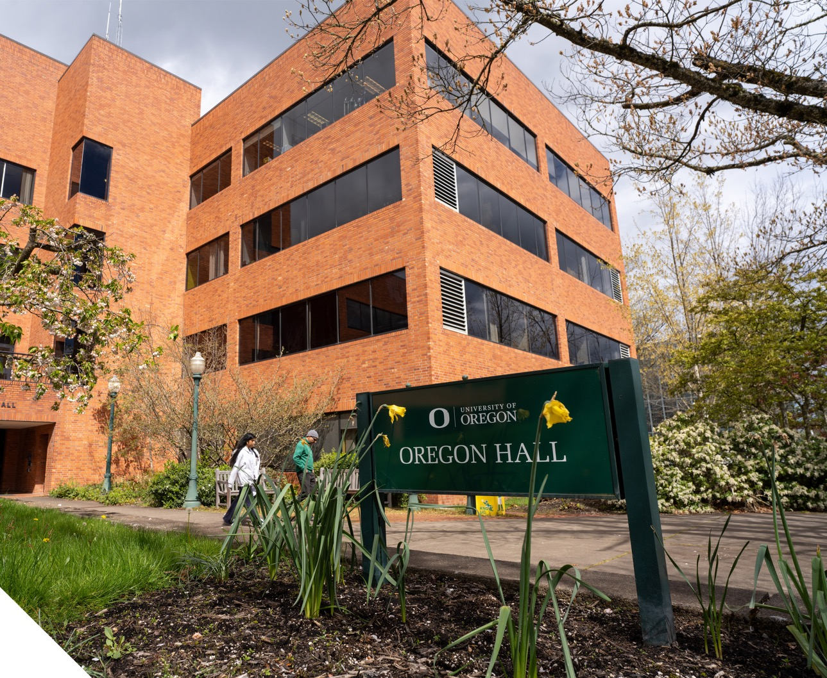
ISSS Advising Office Hours
  Office: Oregon Hall, 3rd floor
  Phone: 541-346-3206
  Email: intl@uoregon.edu
  Call-in Advising (same day call back)
  Weekdays (except Thursday) 9:00 am - 3:00 pm
  Walk-In Advising
  Weekdays (except Thursday) 1:30 - 3:30 pm
17

